Slide 1
New Employee Orientation
College of Medicine

Slide 2
Table of Contents
Overview
  Mission & Vision
  Values
  Departments and Offices
Department Expectations
  Dress Code
  Training
Parking
Cougar Card/Badge
AWA
Employee Grievance Process
Department Resources
  HR
  IT and Support Requests
  Facilities and Operations
  Marketing

Slide 3
Tilman J. Fertitta Family College of Medicine Overview
Mission
  Tilman J. Fertitta Family College of Medicine is accountable to society for improving the overall health and health care of the population of Greater Houston, Texas and beyond.

Slide 4
Values
Respect
Integrity
Servant Leadership
Equity
Notes:
Respect – Develop a culture of respect where compassion, active listening, appreciation and constructive collaboration are foremost.
Integrity – Be mindful and reflective about our behavior while maintaining honest and authentic professional relationships. Maintain a standard that supports ethical, moral, and evidence-based decisions. Hold oneself and others accountable to the continuous pursuit of excellence.
Servant leadership – Lead with compassion, humility, openness, and supportive behaviors.
Equity – Our commitment to fostering an inclusive and unbiased environment and holding space for safe dialogue.

Slide 5
Departments and Offices
College of Medicine – Departments
Department of
Biomedical Sciences
Department of
Behavior
and
Social Sciences
Department of
Health Systems &
Population Health Sciences
Department of
Clinical Sciences
Humana Integrated Health System Sciences Institute

Slide 6
Departments and Offices
College of Medicine - Offices
Office of the Dean
Office of Faculty Affairs &
Graduate Medical Education
Office of Research
Office of Medical Education
Office of Student Affairs, Admissions, & Student Pathways
Office of Community Health

Slide 7
Department Expectations
Tillman J. Fertitta Family College of Medicine faculty, staff and students are representatives of the College and University of Houston.
This is a professional school, and as such, it is expected that faculty, staff and students display an appropriate level of judgment with regard to personal hygiene, grooming and dress.
Faculty, staff and students must maintain an appearance that demonstrates respect and meets professional standards in all non-clinical and clinical activities.
Effective September 1, 2022, the College is adopting Business Casual Attire as our day-to-day standard dress code.

Slide 8
Department Expectations
Dress Code
  Business Casual **Day to Day**
    Examples:
      Slacks with collared shirt
      Slacks or skirt with blouse
      Dress
    Unacceptable attire includes but is not limited to:
      Clothing that exposes the navel
      Denim jeans
      Mini-skirts
      Halter, low-cut, cropped, or ill-fitting tops
      Flip flops, slippers, house shoes
      Shorts
      Leggings, sweatpants, or other exercise attire
Note: Jeans and appropriate Business Casual tops are acceptable on Fridays and Cougar Red and UH branded attire is encouraged. Jeans may not have holes or rips, be ill fitting, or otherwise diminish the professionalism of the College.

Slide 9
Department Expectations
Dress Code
  Business Professional Attire **As Appropriate**
    Slacks with collared shirt and tie
    Slacks or skirt with blouse
    Dress
    All clothing must fit so that inappropriate exposure does not occur during normal activities.

Slide 10



Training
Required courses for all COM employees:
  HIPAA (SH2303)
  Texas Medical Privacy Act (SH2301)
  CMS Medicare Fraud Waste & Abuse (HO2302)
  CMS General Compliance (HO2303)
To view training queue:
    Go to your AccessUH home page: accessuh.uh.edu/index.php
    Under “Administrative Services” click on the HR P.A.S.S. icon
    Click on the Training tile
    View Training Summary

Slide 11
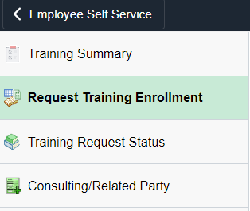
Training
How to Access:
    Go to your AccessUH home page: https://accessuh.uh.edu/login.php
    Under “Administrative Services” click on the HR P.A.S.S. icon
    Click on the Training tile
    Request Training Enrollment
    Search by Course Name or Search by Course Number

Slide 12
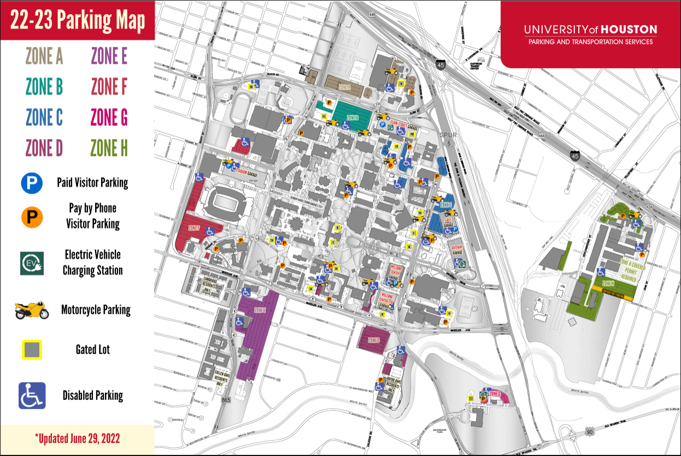
Parking
View Parking Permits homepage for Faculty & Staff here:
  https://uh.edu/parking/parking-on-campus/permits/
  College of Medicine Parking located in Zone G for Med1 Building staff and Zone D for UH Health FCC staff (clinic)

Slide 13
Cougar Card/ Badge
Get Your Cougar Card
  Complete online photo submission
    To get your Cougar Card, first complete the online photo submission in AccessUH Cougar Card Connect. Please allow 24-48 business hours for your photo to be reviewed. Once your photo submission is reviewed you will receive a confirmation email indicating that your photo has been approved or denied.
  Pick up your Cougar Card
    Once your online photo submission is approved, please schedule an appointment or join our virtual line for same day assistance through AccessUH CougarQ Queuing and Appointments. Your Cougar Card will be printed at the time of your appointment.
  Please note: if you are attending New Student Orientation, you will receive specific instructions on how to get your Cougar Card. For more information, visit our New Student Orientation page.

Slide 14
Alternative Work Arrangement - COM
University of Houston - Alternative Work Arrangement Overview
Arrangement offered at the College of Medicine –
  Hybrid/Alternative Work Locations (some work on-site and some off-site)
6-month orientation required for all College of Medicine employees (subject to COM Dean, Department Chair, AVP, and direct-supervisor approval)
  Includes transfers from University as well as roles
Approval timeline: ~4 weeks

Slide 15
Employee Grievances
STAFF
FACULTY
MAPP 02.04.01
COM Contact:
  Marie Jeanne Nisnisan, MHA
  College Business Administrator – HR
  Email: Mmnisnis@central.uh.edu
  Phone:
  (713) 743-8997
University Grievance Policy
COM Contact:
  Dr. Jacqueline Levesque
  Associate Dean, GME & Faculty Affairs
  Email: jelevesq@central.uh.edu
  Phone:
  (713) 743-9564

Slide 16
Department Resources
College Business Administrator - HR
  Marie Jeanne Nisnisan, MHA
  E: Mmnisnis@cougarnet.uh.edu
  P: (713) 743-8997

Slide 17
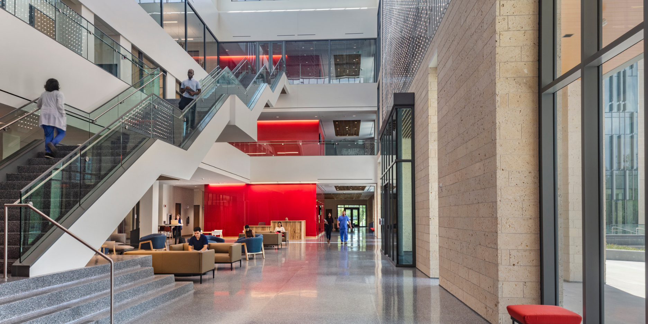
Department Resources
IT and IT Support Requests
Contact:
Email: uhcom-it@UofH.uh.edu
Facilities
Hours of Operation: 8 AM – 5 PM
Contact:
Areli Mbaye
College Business Administrator
Email: aambaye@central.uh.edu
  Phone: 713-743-9060

Slide 18

Department Resources
Marketing Guidelines
UH Brand Style Guidelines: https://uh.edu/brand/brand-identity/style-guide/index
Includes colors, typography, graphic design, photography, video and copy & editorial

Slide 19
Department Resources
University Marketing and Communications – Email Signature Guidelines
Font
Trebuchet, 10 point
Color
Black type except the name of the University in red.
Example
Jane Doe
Department Manager
Department Name
University of Houston
713-743-0000
uh.edu
Confidentiality clause
If you work with confidential information, the confidentiality clause may be included at the bottom of the email signature.
Example
Confidentiality Notice: The information in this e-mail may be confidential and/or privileged. If you are not the intended recipient, any review, dissemination, or copying of this e-mail and its attachments, if any, or the information contained herein is prohibited. If you have received this e-mail in error, please immediately notify the sender by return e-mail and delete this e-mail from your computer.

