Slide 1
Funding Options
Trina Barker, M.Ed.
Program Manager 2
tmbarke2@central.uh.edu
Room 1511

Slide 2

Funding Resources
There are several funding sources available at the UH
  The College of Medicine Department of Student Affairs has the College of Medicine Travel Grant.
    COM Travel Grant can cover up to $500/year in allowable travel expenses
  Cullen Fellowship Travel Grant: Competitive fellowship program through the UH Graduate School
  CFTG will cover up to 75% allowable travel expenses (hotel or conference housing, transportation, registration costs) or up to $750.00, whichever is less
  Deadline for application can be found on their website:
    https://uh.edu/graduate-school/graduate-funding/
  The University of Houston Activity Funding Board (must be a registered student organization)
    https://www.uh.edu/afb/
*Check with the conference/event organizers to see if they have any additional funding sources
*If this is a grant funded research, check with the PI to see if there are any travel funds in the grant

Slide 3

College of Medicine
Request for Funding assistance must be submitted at least 8 weeks before payment for conference/event is due
*Any item paid for before your travel is approved by the business office and UH Concur may not be eligible for reimbursement
To be eligible for funding through the College of Medicine:
You must have a Payment Works vendor ID number
You must be invited to speak/present at the conference
    Submit all estimate of travel expenses to Trina Barker/Denise Delgado through the College of Medicine Travel Grant Request Form.
    You must have written permission from OME, the LIC director or the ACE director to miss a class or clinical rotation

Slide 4

Student Travel Requirements
The University of Houston sets guidelines for student travel that all students must follow.
This include:
  Meetings of academic organizations where a student is officially representing the University
  Student attendance or presentations at professional organizations
The Tilman J. Fertitta Family College of Medicine Procedures:
  Check the academic calendar to be sure travel will not interfere with any exams or assessments
  Notify Trina Barker in Student Affairs that you are interested in traveling to the event
  Receive a written invitation from the conference/event organizers to Present a Poster or Speak on a topic.
  Receive written permission from OME for any absences from classes or rotations at least four weeks in advance. If no classes will be missed be sure to indicate this on your travel request form.

Slide 5
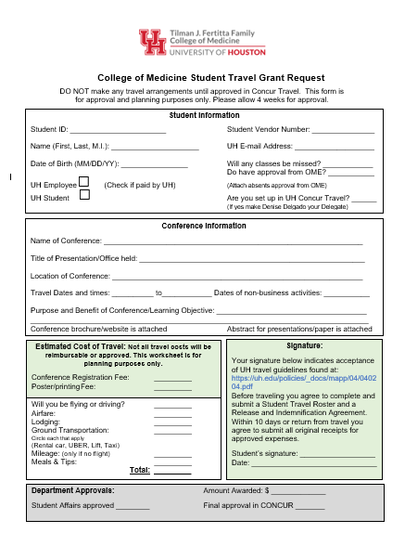
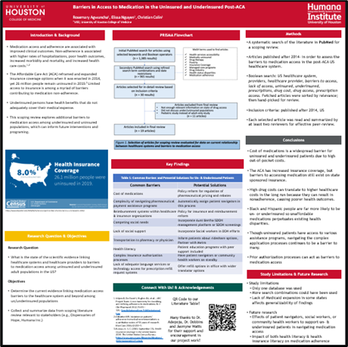
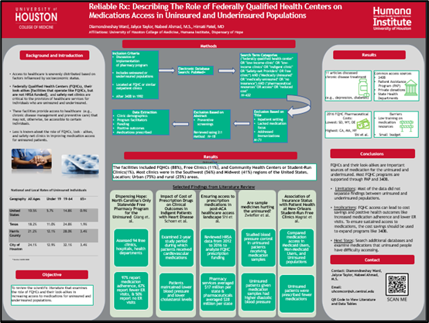
COM Student Travel Grant Request

Slide 6

Questions ?

