Slide 1
Tips for Applying to Graduate School
Dr. Rodica Damian
Assistant Professor of Social-personality psychology
University of Houston

Slide 2
Start planning early
Timeline: Start planning early
2-3 years before applying (~ sophomore year)
Build a strong GPA
Join a lab
Build professional relationships with Professors
1-2 years before applying (~ junior year)
Gain research experience
Research graduate programs
Take GRE
Summer and fall of application season (~ senior year)
Ask for letters of recommendation early in the year
Request official transcripts
Submit applications
Work on Personal Statement

Slide 3
What type of program is right for me?
Talk to academic advisors and/or professors
Talk to those doing what you’re interested in
Volunteer in different fields/settings/research labs to better understand your options
Check out the American Psychological Association link on graduate education
  http://www.apa.org/education/grad/index.aspx

Slide 4
Select Programs
Decide on a degree
  MA, PhD, PsyD
Decide on area
  Social/Personality, Clinical, Industrial/Organizational, Developmental, Cognitive, Quantitative, Counseling, School Counseling, Social Work, Forensic, Health, Community, Human Development, Psychiatry/Psychiatric Nursing, Behavioral Neuroscience, Animal Behavior, etc.

Slide 5

Select Programs
Select schools
  Department not university rankings matter
  Be sure to check the ranking of the specific department you plan to join, as it might be different from the general university ranking
  For PhDs, the advisor is more important
Select about 15-20 potential programs based on their match with your academic record, research experience, research interests, and career goals
Narrow down the list based on faculty advisor fit

Slide 6
Select Programs
Identify professors who share your research interests, read journal articles they authored
For programs on your initial list, review the program website and the research interests of faculty members. Identify programs where your research interests are compatible with 2-3 potential mentors, as an interest in working with multiple faculty will boost your likelihood of attracting interest from at least one of them.
Contact potential mentors to see whether they are accepting a new student during the next application cycle. If not, cut that potential mentor from your list. See more info here: https://www.psychologytoday.com/us/blog/grad-school-guru/201410/emailing-future-phd-advisors
Narrow down your list with the goal of applying to 8-12 schools

Slide 7
The PhD Advisor
What’s a good advisor?
  Personality fit
  Mentoring style match (understand lab structure, talk to current grad students)
  Research interest fit
  Fit with other lab members
  Active lab/ active research program
  Experience and placement of previous grad students, but earlier career stage of advisor is not necessarily worse

Slide 8
Application Requirements
GPA (*exceptions apply)
GRE Tests (*check if required)
Research Experience
CV/ Resume
Personal Statement
Recommendation Letters
The Interview

Slide 9
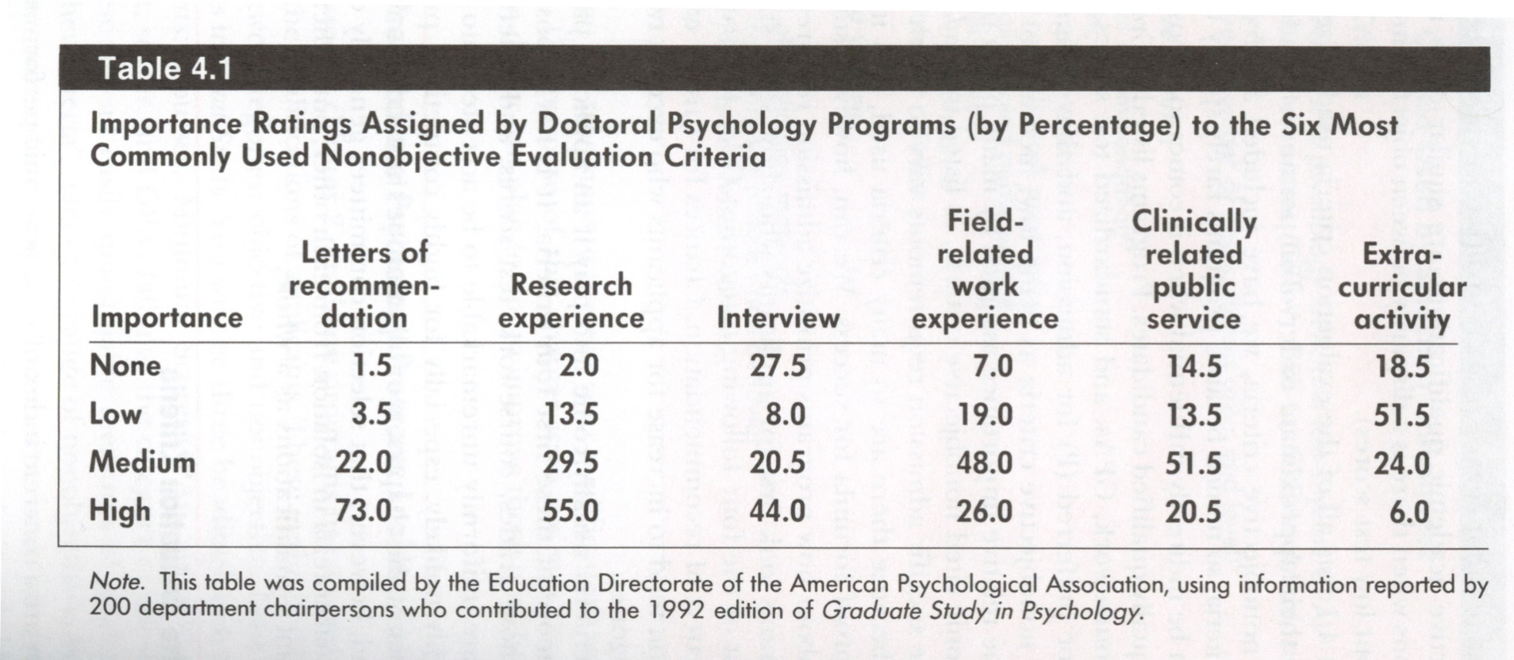
How important are non-objective admission criteria?

Slide 10
GPA
You will need to send official transcripts to each school you apply to
The better your grades, the better your chances, but exceptions apply and you DO NOT need perfect grades
Other aspects of your package may be more important
Optional steps to make your application stellar:
  If you can take methods/statistics courses and do well that can help
  Training yourself in open source statistical programs like R can be a big advantage. There are excellent and free resources online for teaching yourself this program.
  Take free online courses on Coursera in statistics/programming

Slide 11
Graduate Record Examination (GRE)
Take the exam the summer before you apply.
Don’t wait until the last minute. Scores can take up to 6 weeks to process.
Scores are good for 5 years. Take it even if you’re considering waiting a year or two to apply to graduate school:
Keep the price tag in mind:
The exam costs $205 to take.
Sending official scores to schools often includes additional fees.
Look into the GRE Fee Reduction Program for financial assistance.
Ask potential programs if they can accept unofficial scores -- some do and only require your official scores if you’ve been accepted to the program.
Don’t forget to prepare.
The GRE offers a free practice test.
Test-prep books (see Kaplan and ETS) are excellent, range from $30-$60.
Look online for free vocabulary flash cards.
Some programs also require subject GREs.
These are additional exams specific to subject matter, like Psychology. Make sure you know whether your program requires this and factor in the cost of taking and preparing for this exam as well.

Slide 12
Get Prior Research Experience
Faculty members generally offer spots in research labs
  You should work in an least 2 different labs for at least 2 months
  You can contact professors to ask about available positions
  You can also work over the summer, or take a gap year if possible
  Some spots are paid but most are not
  If unpaid, you can volunteer or get course credits
  When working in research labs, show initiative, get involved with research projects, you can even ask to run your own project with supervision, present at conferences, even publish research
An honors thesis will help
If you plan to pursue a PhD, having a prior Master degree will help, but it’s not required

Slide 13
CV

Slide 14
Personal Statement
Read each school’s prompt carefully. Tailor the statement to the program and advisor you’re applying to.
Use a worksheet to prepare your statement. Some examples:
  UCAS Personal Statement Worksheet
  Amherst College - Writing Your Personal Statement
  Old Dominion - Writing an Effective Personal Statement
  Consider using a book as a guide to crafting the best possible statement.
    Example: Donald Asher’s Graduate Admissions Essays

Slide 15
Personal Statement
It's not all about you: Highlight the ways in which your ideas and experiences will help professors develop their own research and reach their own goals
Write different variations, tailored specifically to each program
Write, rewrite, revise, write, rewrite, revise, write, rewrite, revise
Have as many people as possible read it (min 3)
What to include
  What research have you done
  What research do you want to pursue
  Mention specific names of the University, Program, and Faculty that you want to work with & why (obviously, your research should be related to theirs!)
  Chance to address any weakness in your application
  What sets you apart from other applicants
  Previous relevant experiences and skills

Slide 16
Personal Statement DOs
Highlight your fit with the program.
Identify which advisor(s) you are interested in working with and how you see their research fitting with what you would be interested in doing research on.
Highlight your especially desirable qualifications.
Demonstrate the clarity of plans.
Demonstrate your writing skill.
Develop a basic letter focussed on yourself, and then tailor copies of it for each program you apply to.

Slide 17
Personal Statement DOs
Proofread thoroughly, spelling and grammar errors can be real problems.
Ask faculty or advisors to look over your letter before sending it out, but only after it is in good shape.
Set out what combination of interests, activities and achievements makes you unique.
Include how this would contribute to your long term career goals.
Include anecdotes and describe how they affected your interest in an area.
Demonstrate how you go above and beyond what is expected to generate positive results.

Slide 18
Personal Statement DONTs
Don’t use humour or jokes, save your wit for in person.
Don’t exaggerate or use hyperbole, e.g “I never have interpersonal conflicts”
Don’t talk about personal hardships you have experienced, like depression, substance abuse or family turmoil. Discussion of your personal mental health issues is a particular red flag to possible advisors.
Avoid generic statements like “I did an internship” or “I have a lot of research experience”, provide specific details.
Avoid odd salutations, stick to “Dear” and “Regards” or other common salutations.

Slide 19
Personal Statement DONTs
Don’t add long unnecessary anecdotes or recap extensively information from elsewhere in your application without clear links to why it makes you more interested in this graduate program.
Don’t use excessively religious references, while being religious is totally fine, it generally doesn’t impact your ability to be a quality scientist. Overly religious statements “I have a god given gift for understanding people and directing them back to god’s path” could harm your chances.
Don’t be critical of your undergraduate institution.
Don’t share overly personal information, possible advisors can see this as having poor interpersonal boundaries.

Slide 20
Recommendation Letters
You will need at least 3 letters from university professors
  Select people who know you (ideally you have worked in their research labs/ clinical practice for at least 2 months)
When to ask
  The sooner the better
  Send gentle reminder email to check in 2 weeks before each deadline

Slide 21
Recommendation Letters
What to include when asking for a recommendation
  Prepare a folder of all your info for each writer
  Resume/CV, Transcript/Courses Taken with grade
  Personal Statement (so they can match their letter with your interests/goals as much as possible)
  Spreadsheet of all the schools, deadlines, what to include, how to submit (email, online, return to student, etc.)
  Preaddressed/Stamped envelopes for those that need to be snail mailed (hopefully none will be needed, very rare)

Slide 22
Interviews
If your written application is successful, you may be invited to an interview.
May be after you’ve received an offer.
May be just the next step in the application process.
Interviews are always 2-way streets: this is an opportunity for you to decide whether the program is right for you.

Slide 23
Interviews: Put your best foot forward
Pay attention to your body language / eye contact.
Every interaction is important! Showing respect towards every person you meet can go a long way.
Bring questions and always be prepared to ask them, but don’t forget to take turns in any conversation
Know the answers to questions about your interests, motivations, goals, abilities and experience
Try to know who you will be meeting with ahead of time.
  Spend some time doing a ‘deep dive’ on the program prior to your interviews.
Google interview tips & sample interview questions
Dress professionally, but make sure you feel comfortable spending the entire day in the outfit you choose
Take bathroom breaks when they are offered, even if it’s just to have some down time to collect your thoughts
Be yourself! Being a little nervous is okay and expected. It shows that you’re excited about the possibility of attending the program.

Slide 24
Interviews: Use the opportunity to learn more
Learn everything you can about the success and well-being of current students.
  Ask current students what they like and dislike, what issues have come up in the past, how those issues have been resolved.
  How long do students typically spend in the program? Are students successful at finding jobs after graduation? In what kinds of careers?
  What opportunities for training or development are unique to this program?
Keep your well-being in mind.
  Will you be comfortable living in this city for 2-6 years? Will you feel safe?
  It’s ok to consider constraints on location, especially if you’re responsible for other people.

Slide 25
Acceptance
Accepted
  How long do I have to decide?
    Standard Deadline: April 15
  Notify programs where you interviewed of offers (they will generally also make you an offer, if similarly ranked, which might increase your salary)
  Do not feel pressured to accept an offer early if you may have other options; do not accept any offer immediately.
    But be courteous… once you know your decision, let programs know so they can reach out to their waitlist.
Wait Listed
  Deadlines
  Position/# on the list
Notes:
Once the program accepts you, you have until April 15th to tell them your decision (whether you accept/will join their program, or not).
Be courteous… once you know your decision for sure, consider letting them know soon. Other people may be waitlisted. It is not required, but more like being a good citizen.
If waitlisted, they should tell you what position/number you are on the waitlist. If you’re near the top, there’s a pretty good chance you could still be accepted later (if the first round of people they accepted have declined/decided to go elsewhere). But if the others don’t get back to them until April 15th, it may be after April 15th that you get accepted. Which would be after you have to tell other schools of your decision if you’re accepted there. So you have to hedge your bets.
If rejected – try not to get too discouraged! So much goes into the “FIT”
Could consider doing Master’s program first, then later do PhD program

Slide 26
What happens if I am not accepted anywhere?
Although this is disappointing, try not to be too discouraged. Many qualified people are not accepted the first (or even second) time.
What now?
    Reassess (goodness of fit for programs you’re applying to)
    Gain more research experience
    Reapply (possibly to other programs) next year
    Apply to a Master’s program before pursuing a doctoral degree
    Get a full-time job in Psychology for one or two years, and then re-apply
    Consider an alternative plan

