Slide 1


Stepping into Graduate School & Careers in Psychology
April 1, 2021

Slide 2
Goals for Today’s Webinar
Present overview of psychology-related careers
Explain grad school options in psychology (and tips for applying + financing)
Provide general career advice (e.g., about being a grad student and landing a job in sports)
Answer lots of questions
NOT: persuade you to go to grad school, or pursue any particular career

Slide 3
Schedule
12:00-12:20 – Career Options in Psychology – Professor Kevin Hoff
12:20-12:55 – Grad Programs in Psychology – Professor Arturo Hernandez
1:00-1:35 – Tips for Applying to Grad School – Professor Rodica Damian
1:35-1:55 – Financing your Education – Professor Christiane Spitzmueller
2:00-2:25 – Life as a Graduate Student – Lindsay Santacroce & Joanne Angosta (current grad students at UH)
2:25-3:00 – How Psychology Can Land You a Job in Sports – Ehsan Bokhari (Director of Player Evaluation for the Houston Astros)

Slide 4
Schedule
12:00-12:20 – Career Options in Psychology – Professor Kevin Hoff
12:20-12:55 – Grad Programs in Psychology – Professor Arturo Hernandez
1:00-1:35 – Tips for Applying to Grad School – Professor Rodica Damian
1:35-1:55 – Financing your Education – Professor Christiane Spitzmueller
2:00-2:25 – Life as a Graduate Student – Lindsay Santacroce & Joanne Angosta (current grad students at UH)
2:25-3:00 – How Psychology Can Land You a Job in Sports – Ehsan Bokhari (Director of Player Evaluation for the Houston Astros)

Slide 5





Psychology is broad!

Slide 6
Psychology Careers
Psychology is relevant in MANY different jobs
Many, but not all, psychology-specific jobs require a graduate degree
  E.g., Therapist licensure often requires a Master’s degrees or higher
You can still get into grad school if you didn’t major in psychology
  Sometimes requires gaining additional experience

Slide 7

What can I do with an Associate’s degree in psychology?
Psychology jobs requiring a (2-year) Associate’s degree:
  Teacher’s Aide
  Family Advocate
  Youth Counselor
  Home Care aide
  Research Assistant
  Mental Health Technician
  Crisis Intervention Counselor
  Social Work Assistant

Slide 8

What can I do with a Bachelor’s degree in psychology?
More options open with a Bachelor’s degree:
  Management and Administration
  Sales
  Social Work
  Human Resources
  Administrative Positions
  Real Estate
  Business Services
  Insurance
  Marketing

Slide 9
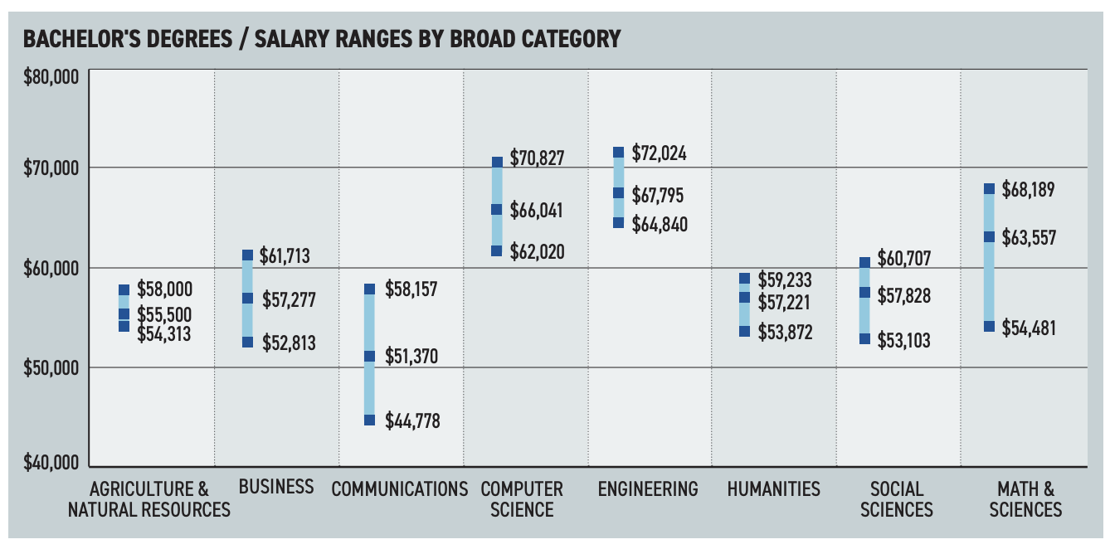
2019 NACE Salary Survey

Slide 10
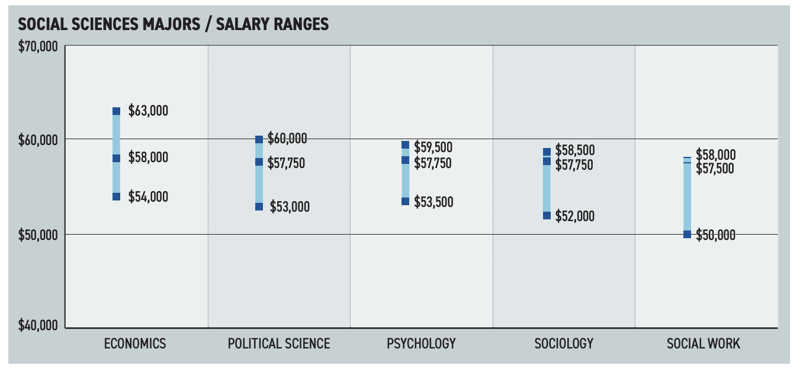
2019 NACE Salary Survey

Slide 11

What can I do with a Master’s degree in psychology?
Master’s in a wide range of fields:
  Mental Health Counseling
  School Counseling
  Social Work (M.S.W.)
  Substance Abuse Counseling
  Education (M.Ed.)
  Rehabilitation Counseling
  Public Health (M.P.H.)
  Marriage & Family Therapy
  Human Resources

Slide 12
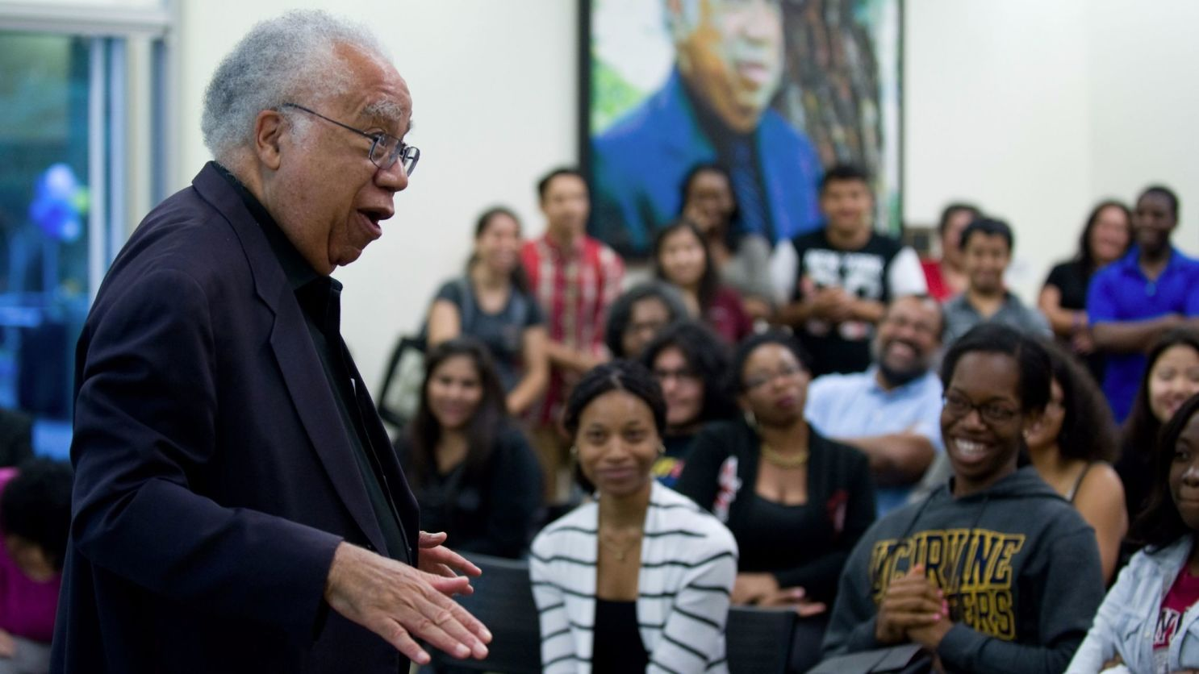
What can I do with a Doctoral degree in psychology?
Doctoral degrees provide more in-depth training in specific fields:
  Clinical
  Counseling
  Educational
  School
  Developmental
  Social
  Personality
  Neuroscience
  Cognitive
  Industrial-Organizational

Slide 13
Career Advice
  TV shows and movies can be misleading
    Ask real people!
    Some psychology jobs are harder to get than others
  You never know until you try
  Credentials open doors, but your skills matter more

Slide 14

Career Exploration Ideas
Talk to advisors/instructors
Conduct an informational interview
Job shadow
Volunteer
Gain research experience
Obtain a (part-time) job
Get involved in clubs or special interest groups
Talk to a Career Counselor
Use the Internet

Slide 15
Online Resources
O*NET
Occupational Outlook Handbook
What can I do with this major?
UH Path’s in Psychology website
Job search websites (e.g., Indeed, USA Jobs)
Your career center website

Slide 16
Schedule
12:00-12:20 – Career Options in Psychology – Professor Kevin Hoff
12:20-12:55 – Grad Programs in Psychology – Professor Arturo Hernandez
1:00-1:35 – Tips for Applying to Grad School – Professor Rodica Damian
1:35-1:55 – Financing your Education – Professor Christiane Spitzmueller
2:00-2:25 – Life as a Graduate Student – Lindsay Santacroce & Joanne Angosta (current grad students at UH)
2:25-3:00 – How Psychology Can Land You a Job in Sports – Ehsan Bokhari (Director of Player Evaluation for the Houston Astros)

Slide 17
Schedule
12:00-12:20 – Career Options in Psychology – Professor Kevin Hoff
12:20-12:55 – Grad Programs in Psychology – Professor Arturo Hernandez
1:00-1:35 – Tips for Applying to Grad School – Professor Rodica Damian
1:35-1:55 – Financing your Education – Professor Christiane Spitzmueller
2:00-2:25 – Life as a Graduate Student – Lindsay Santacroce & Joanne Angosta (current grad students at UH)
2:25-3:00 – How Psychology Can Land You a Job in Sports – Ehsan Bokhari (Director of Player Evaluation for the Houston Astros)

Slide 18
Stepping into Graduate School & Careers in Psychology
April 1, 2021

